Slide 1
The Genotype Ontology
An OWL Model for the Integration and Analysis of G2P Data
Monarch All hands Workshop
February 9 , 2016
Matthew Brush
Ontology PURL: http://purl.obolibrary.org/obo/geno.owl

Slide 2
GENO Overview
Coverage
Genotypes and their component elements of genetic variation (across human and model organism G2P databases)
Additional terms needed to describe these elements and represent G2P associations (e.g. environmental context, evidence/provenance)
Goal
Support integration and analysis of G2P data under a unified semantic framework
Development
Openly developed on Github (link) under Monarch Initiative organization
Aligned with OBO Foundry principles, under BFO framework
Reuses terms from existing models (SO, FALDO, OBAN, IAO, GO, OBI)
Development thus far driven primarily by Monarch data and use cases

Slide 3
GENO in Monarch
Part of Monarch ontology import chain loaded into SciGraph
Provides ontology terms and design patterns used to structure rdf graphs generated from source data through DIPper pipeline
Leveraged by Cypher queries to serve data to Monarch website and web services
Encodes logic that supports analysis and inference use cases driven by Monarch Initiative tools and algorithms (e.g. phenotype propagation)

Slide 4
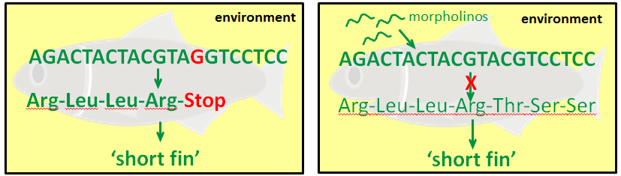
Intrinsic vs Extrinsic Genotypes
The concept of a ‘genotype’ in GENO is viewed broadly to apply to any variation in genomic sequence or variation in gene expression that is tied to an observed phenotypic effect. We distinguish three types of genotypes:
Intrinsic genotypes capture variation in the genomic sequence.
Extrinsic genotypes capture variation in gene expression (resulting from gene targeting technologies such as RNAi, morpholinos).
Effective genotypes capture total variation in gene sequence or expression (intrinsic + extrinsic)
SEQUENCE-VARIATION
EXPRESSION-VARIATION
‘Intrinsic’ Genotype
‘Extrinsic’ Genotype
apc^{hu745/+}; fgf8^{ti282/ti282}(AB)
shhb^{MO1-shhb(2ng);} ihhb^{MO2-ihhb(1ng)}
+
‘Effective’ Genotype
apc^{hu745/+}; fgf8^{ti282/ti282}(AB); shhb^{MO1-shhb(2ng);} ihhb^{MO2-ihhb(1ng)}

Slide 5
Intrinsic Genotype Partonomy
An ‘intrinsic’ genotype is decomposed into its more fundamental components of variation. These represent the ‘levels’ of a genotype at which phenotype associations are made.
AACGTAGCGACGCTCGCTACGGGCGTATC
AACGTAGCGACGCTCGCTACGGGCGTATC
CGTAGC
X
=
X
AACGTACCGACGCTCGCTACGGGCGTATC
AACGTACCGACGCTCGCTACGGGCGTATC
+
CGTACC
X
X
ACAC
GCGAAGTGCCAACTTCTACACACACAAAG
GCGAAGTGCCAACTTCTACACACACAAAG
X
X
ACAC
GCGAAGTGCCAACTTCTACACACACAAAG
GCGAAGTGCCAACTTCTACACACACAAAG
intrinsic genotype
genomic background
genomic variation
complement
apc^{hu745/+}; fgfa8^{ti282/ti282}(AB)
(AB)
apc^{hu745/+}; fgf8a^{ti282/ti282}
X
genomic variation
complement
apc^{hu745/+}; fgf8a^{ti282/ti282}
X
X
has_part
has_part
X
variant single locus
complement
apc^{hu745/+}
has_part
has_part
X
variant allele
apc^{hu745}
has_part
has_part
X
sequence alteration
hu745

Slide 6
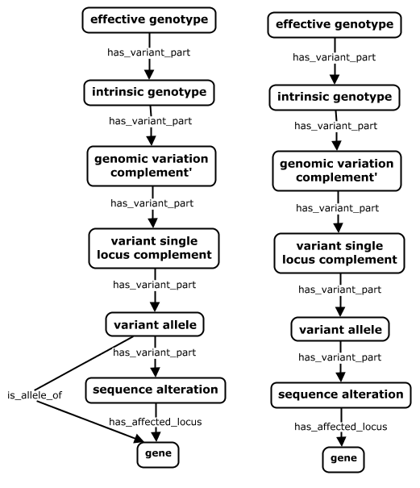
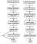
Intrinsic Genotype Partonomy
An ‘intrinsic’ genotype is decomposed into its more fundamental components of variation. These represent the ‘levels’ of a genotype at which phenotype associations are made
Specifies the total variation in genomic sequence or gene expression across a genome.
fgf8a^{ti282a/ti282a};shha^{tbx392/+}[TL]; cdkn1ca^{MO3-cdkn1ca}
Specifies sequence variation across an entire genome in terms of its differences from some genomic background.
fgf8a^{ti282a/ti282a};shha^{tbx392/+}[TL]
The variant portion of a genome, comprised of all allelic complements containing at least one variant allele.
fgf8a^{ti282a/ti282a};shha^{tbx392/+}
The set of all alleles at a locus where at least one is variant
fgf8a^{ti282a/ti282a}
A single locus that contains a sequence alteration
fgf8a^{ti282a}
A single locus whose extent is the deviation from a reference .
ti282a
A locus containing all elements needed to produce functional gene product
fgf8a
Notes:
Retrieve and compare phenotype associations at different levels of the model, across sources

Slide 7
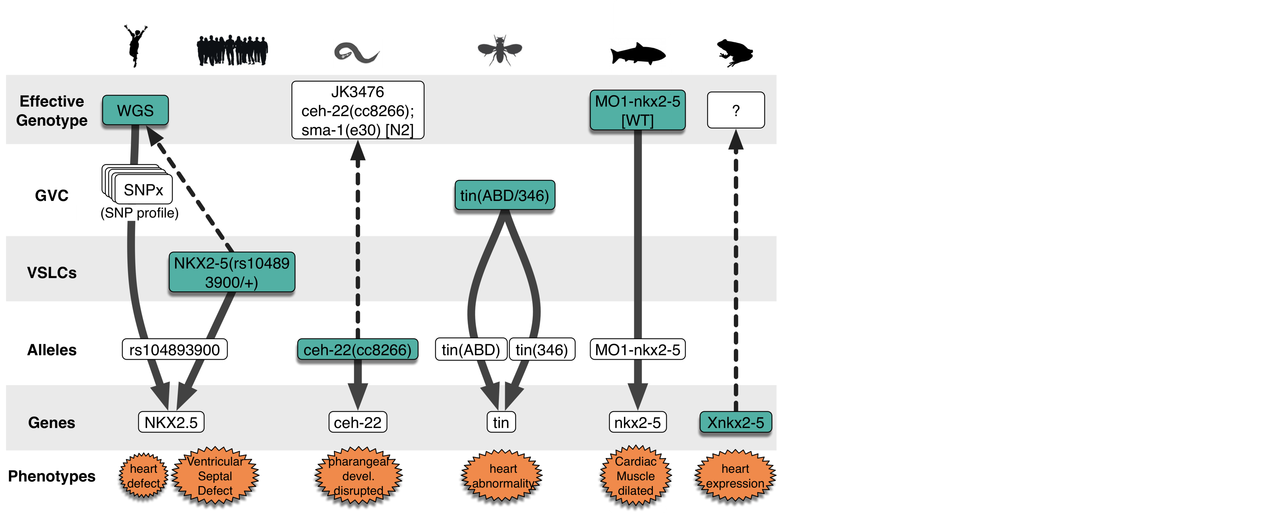
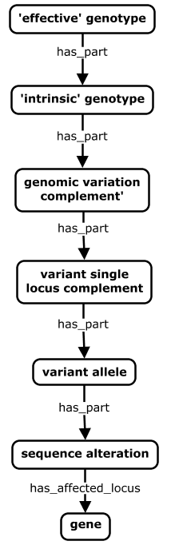


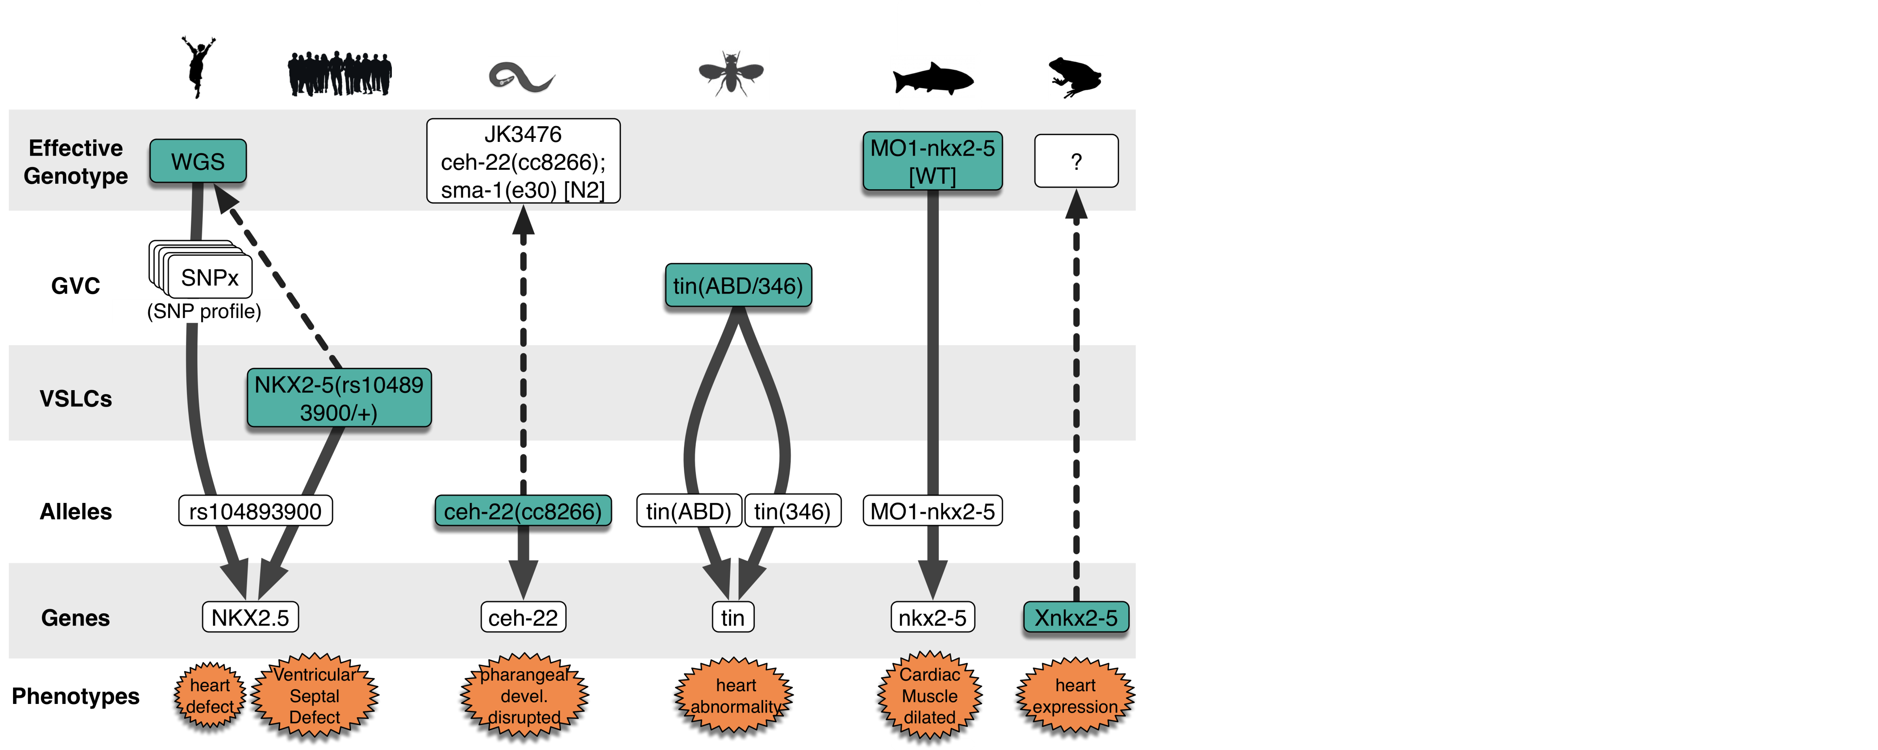

Primary Use Case: Phenotype Propagation
Core genotype partonomy addresses need to compare G2P data across sources that annotate to different levels in a genotype
fgf8a^{ti282a/ti282a};shha^{tbx392/+}[TL]; cdkn1ca^{MO3-cdkn1ca}
Mysm1<tm1a>/Mysm1<tm1a>[C57BL/6]
tin(ABD/346)
daf-2(e1370)
ATP1A3(NM_152296.3)
[c.946G>A, p.Gly316Ser]
Notes:
Retrieve and compare phenotype associations at different levels of the model, across sources

Slide 8
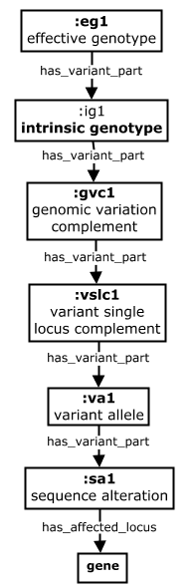
Primary Use Case: Phenotype Propagation
Property chains used to generate inferred phenotype associations
to other parts of the genotype
has_phenotype
gut deformation
fgf8a^{ti282a/ti282a};shha^{tbx392/+}[TL]; cdkn1ca^{MO3-cdkn1ca}
fgf8a^{ti282a/ti282a};shha^{tbx392/+}[TL]
fgf8a^{ti282a/ti282a};shha^{tbx392/+}
Property Chain
is_variant_part_of o
has_phenotype ->
has_phenotype *
fgf8a^{ti282a/ti282a}
fgf8a^{ti282a}
ti282a
* Note that the has_phenotype relation is quite generic (links anything to a phenotype). We are specifying more precise relations to use here.
fgf8a

Slide 9
Primary Use Case: Phenotype Propagation
Property chains used to generate inferred phenotype associations
to other parts of the genotype
Property Chains
is_variant_part_of o
has_phenotype ->
has_phenotype
has_variant_part o
has_phenotype ->
has_phenotype
daf-2(e1370) III; fog-2(oz40) V [n2]
daf-2(e1370) III; fog-2(oz40)V
daf-2(e1370)III
has_phenotype
gut deformation
daf-2(e1370)
e1370
daf-2

Slide 10
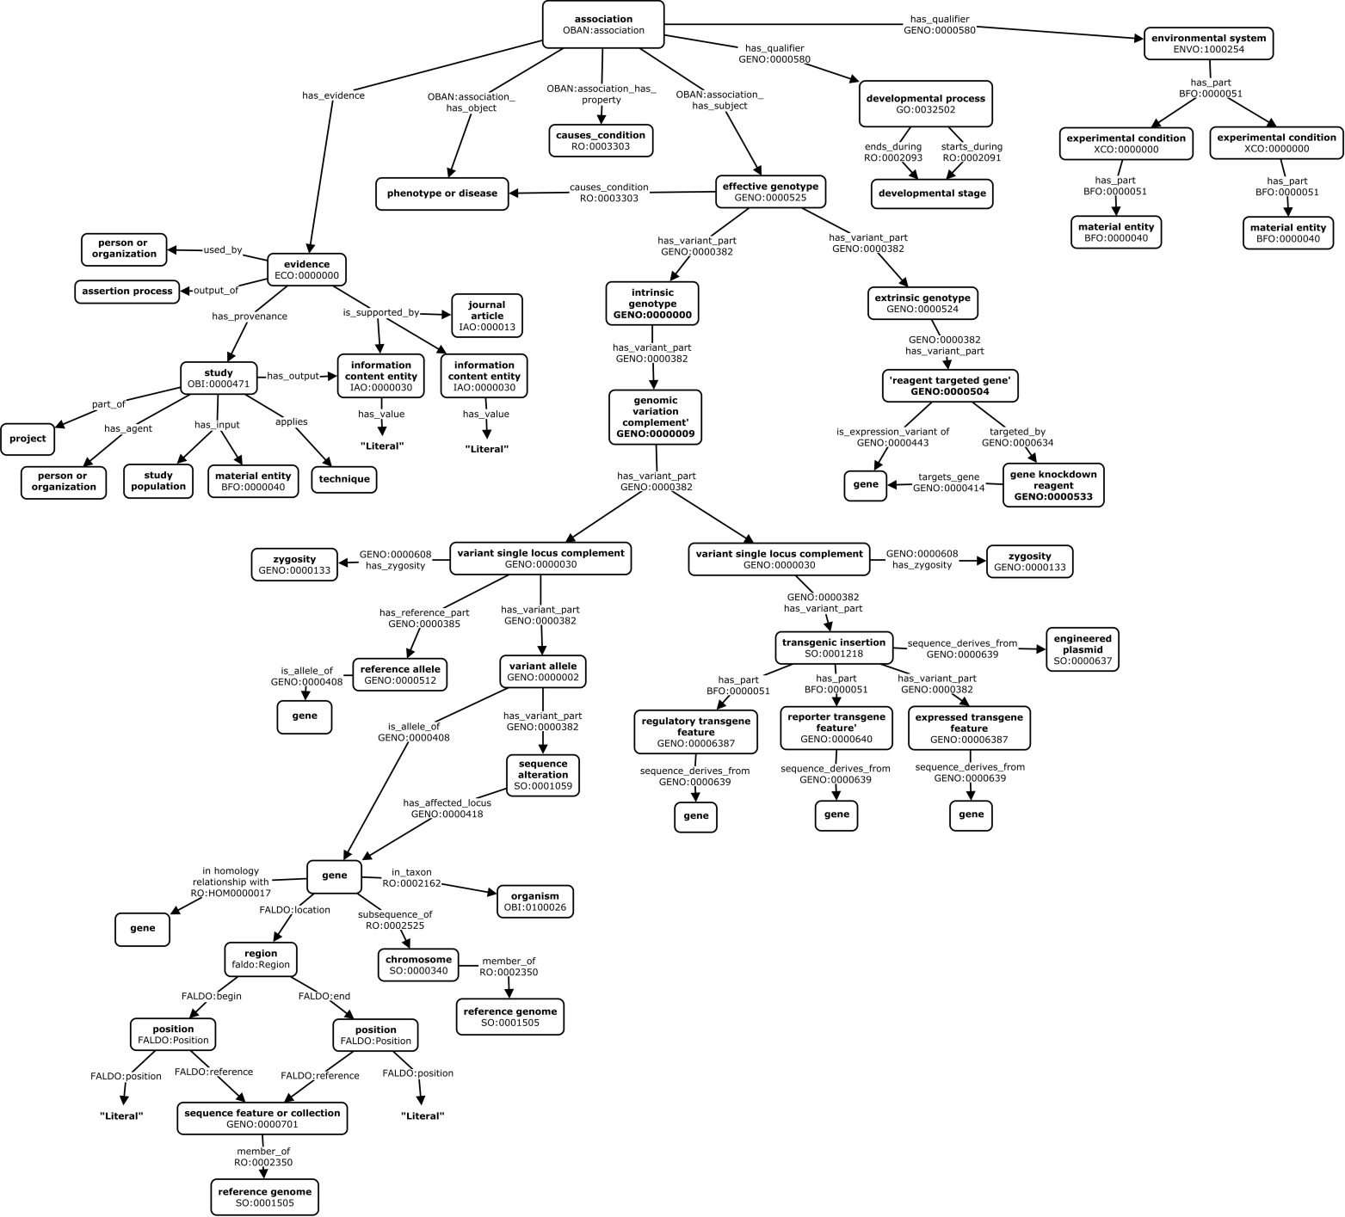
G2P Association Design Patterns in GENO
Association
Model
Developmental Stage
Environment
Evidence
Extrinsic
Genotype
Intrinsic
Genotype
Transgenes
Genes
Genomic
Position

Slide 11
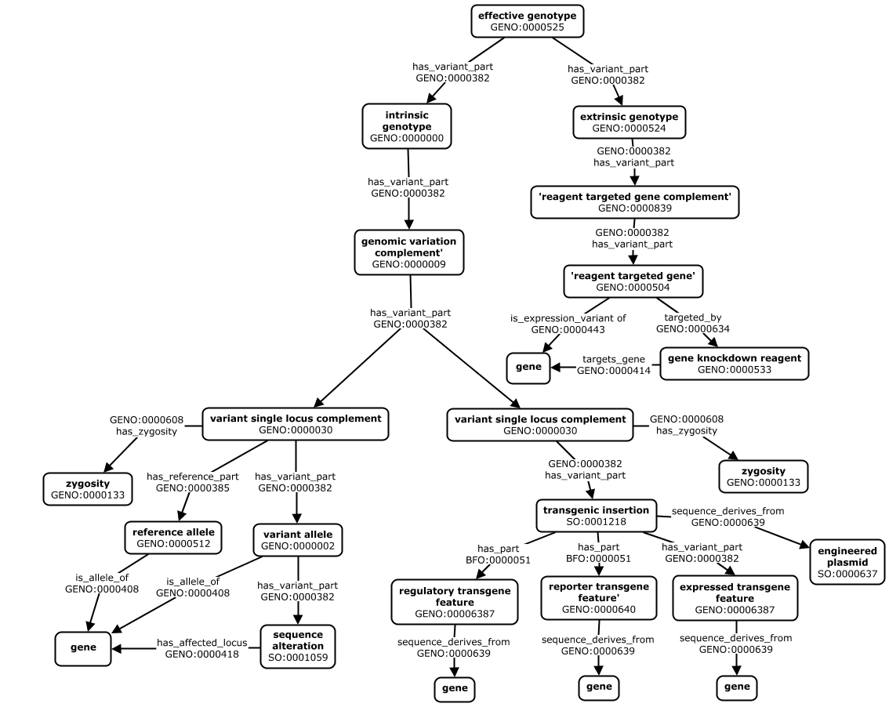
Core Genotype Partonomies

Slide 12
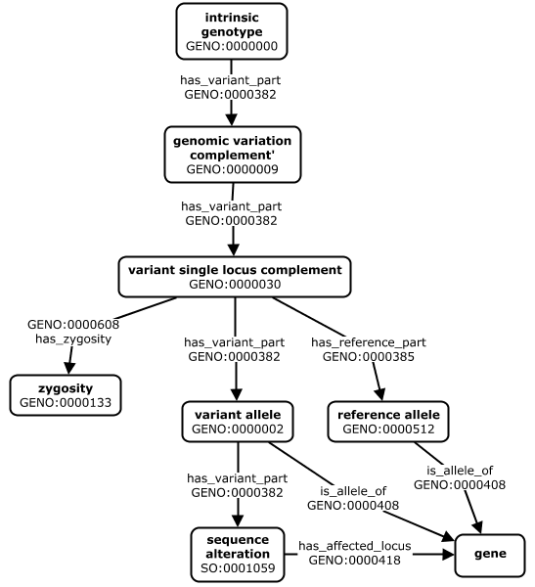
Intrinsic Genotype Partonomy

Slide 13
Extrinsic Genotype Partonomy

Slide 14
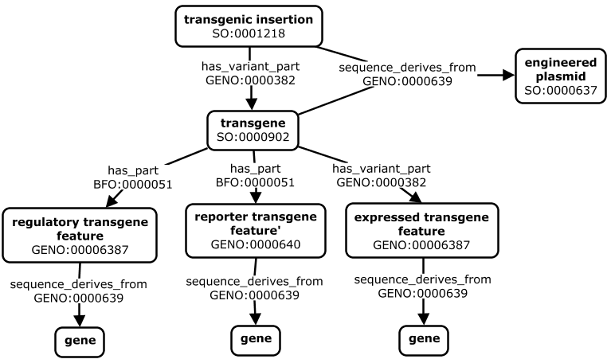
Transgenes

Slide 15
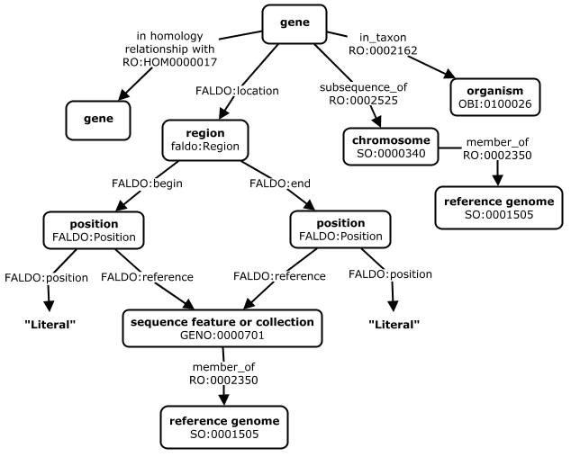
Gene Descriptions

Slide 16
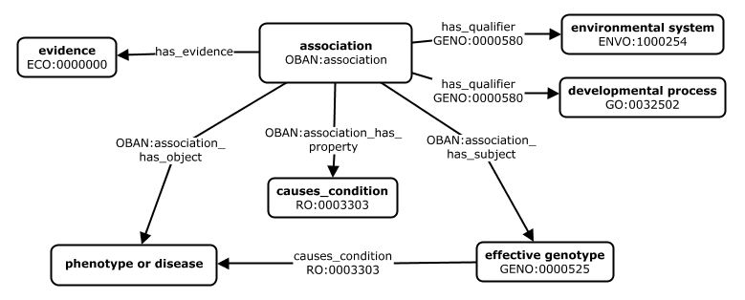
Associations

Slide 17
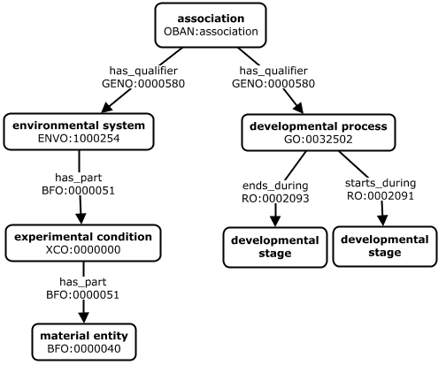
Association ‘Qualifiers’
Environment
Developmental
Stage

Slide 18
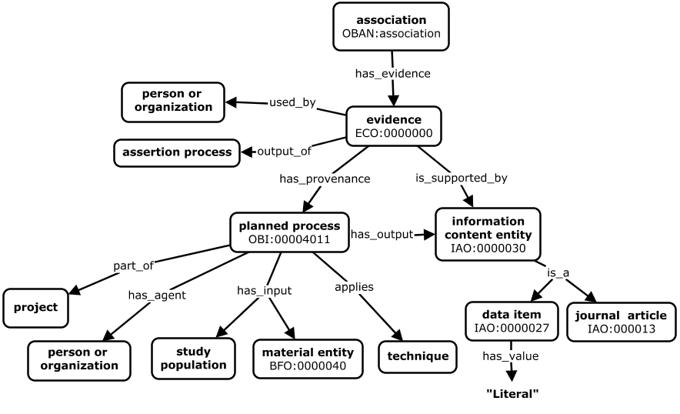
Evidence (Straw Man)

Slide 19
Workflow for and Documentation Generating GENO-Compliant Models
Source data explored and modeled
Data mapped to existing GENO patterns where possible
Existing patterns refine, new patterns defined
Data model implemented in DIPper code
DIPper executed to transform source data according to the model
Data QA and evaluation → iterative model refinement
Ingest of subsequent sources often required update of models for existing sources

Slide 20
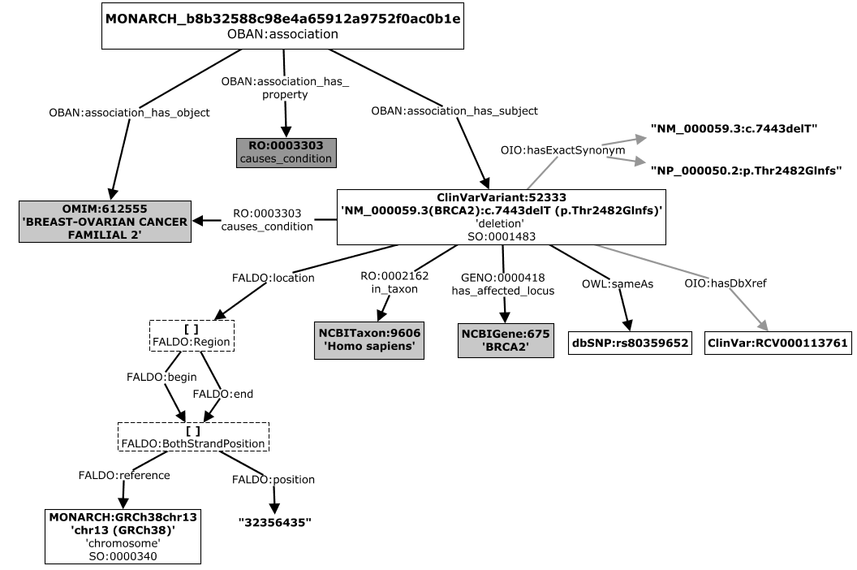
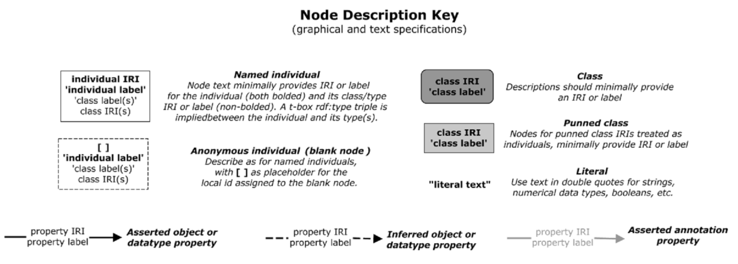
Graphical Concept Maps Provide Specifications of Data Models for Each Source
ClinVar Variant – Disease Association Model

Slide 21
Graphical Concept Maps Provide Shared Specifications of Source Data Models
ClinVar Variant – Disease Association Model

Slide 22
Cmap Documentation Supports Different Users and Use Cases
Monarch Developers
Provides shared view of the domain for ontologists, coders, and domain experts to collaboratively develop and implement models
Ensures consistent representation of similar data cross sources
Monarch Application Users
Gives overall sense of data and relationships they can navigate and query in the system
Third Party Data Scientists and Developers
Provides technical understanding of the data needed to query over, operate on, and integrate data for diverse use cases

Slide 23
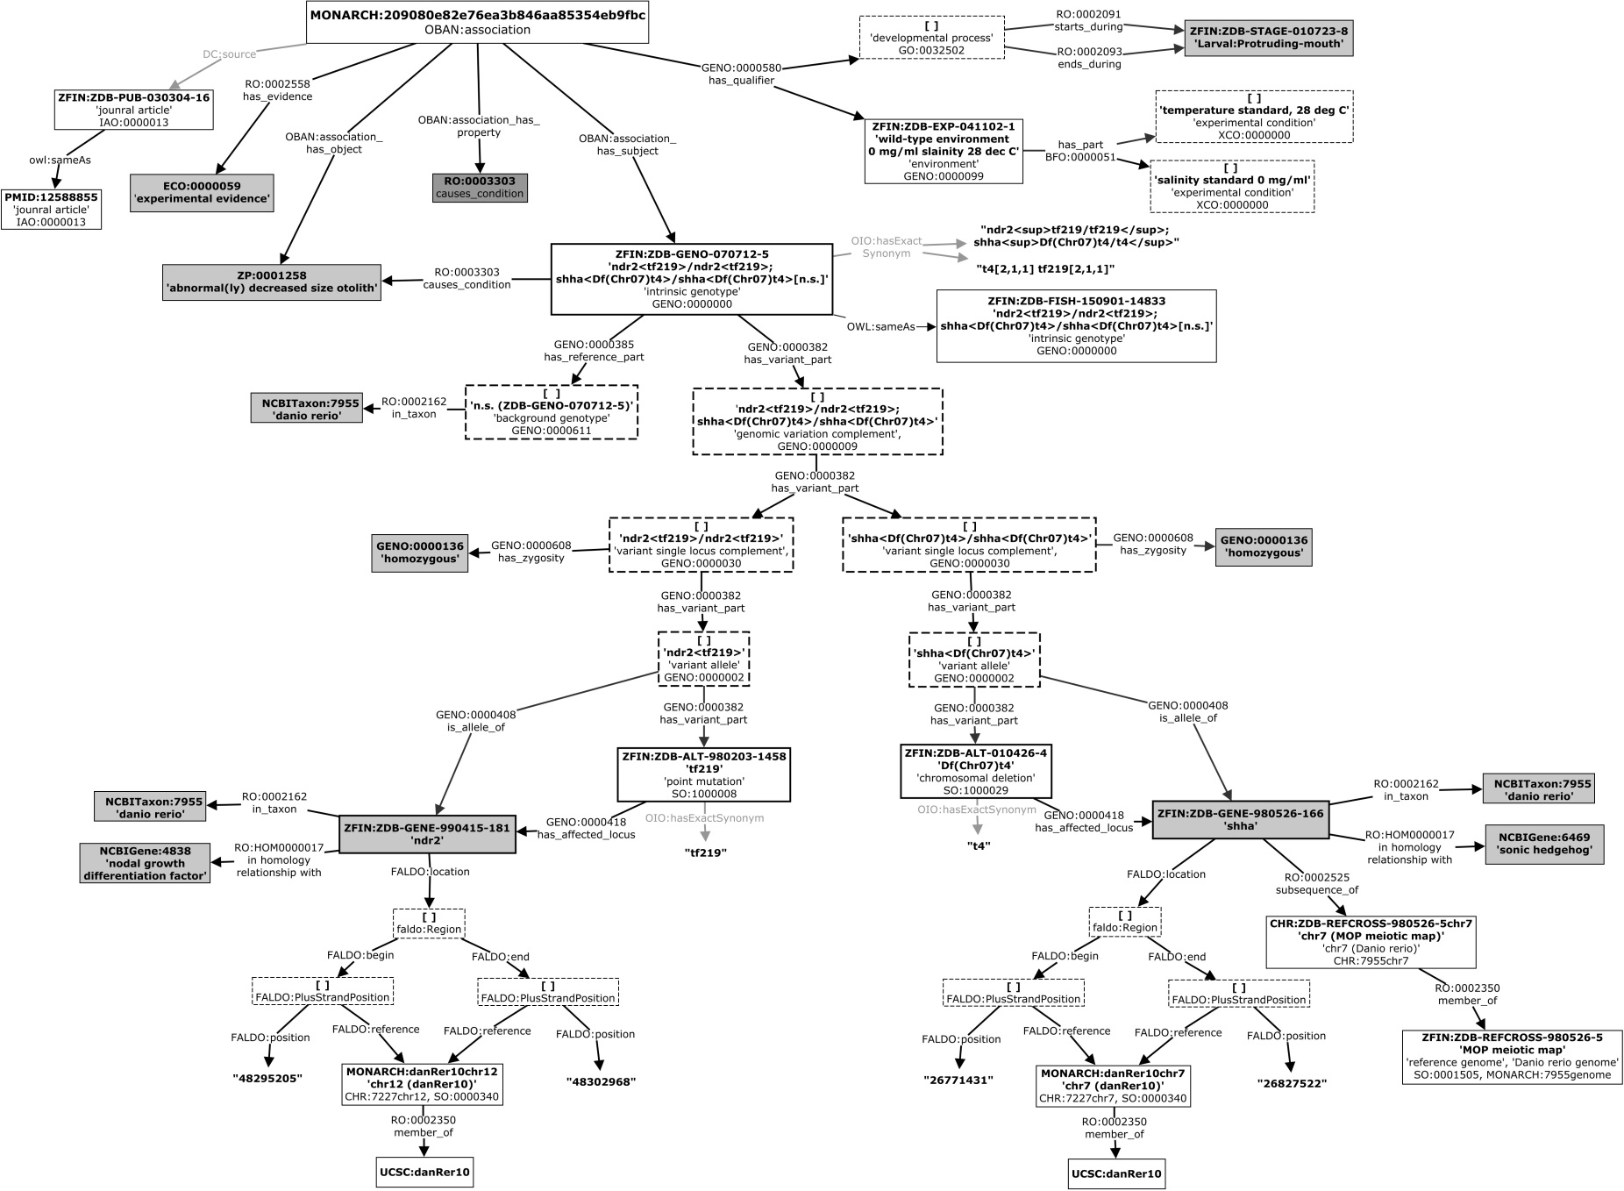
ZFIN Model Concept Map

Slide 24
Goals / Roadmap
Expand modeling
complex transgenics and emerging genome editing technologies (e.g. Crisprs)
environment/experimental conditions
modes of inheritance
epigenetic modification
GWAS associations
Implementation of phenotype propagation
GENO release and publication
Community collaborations and coordination
Better integration with external ontologies
Requirements from external communities
Formalize and finalize common genotype syntax

Slide 25

Challenges and Needs
Replacing Nicole
Feedback on ontology and data modeling
GENO and DIPper models need internal review
DIPper graphical notation and common genotype syntax need internal review
Technical requirements
Need to understand better how ontology and DIPper data is operated on throughout the technology stack (SciGraph, GOLR, OWLSim)
Research requirements:
Researcher-driven use cases and competency questions

